Slide 1
21st April 2021
INSPIRE Action 2.1 1st meeting
Transition
INSPIRE subgroup 2016.5 work
INSPIRE WP 2020-2024 Action 2.1
Stefan Jensen, EEA
Darja Lihteneger, EEA
Joeri Robbrecht, DG ENV

Slide 2
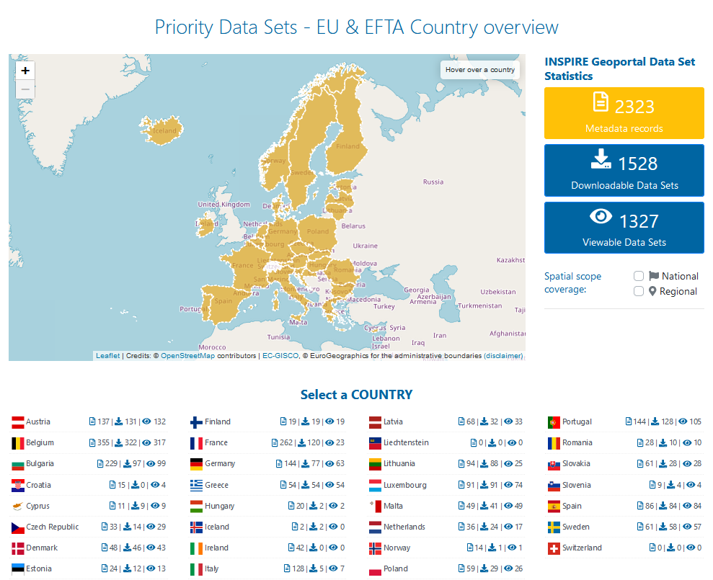
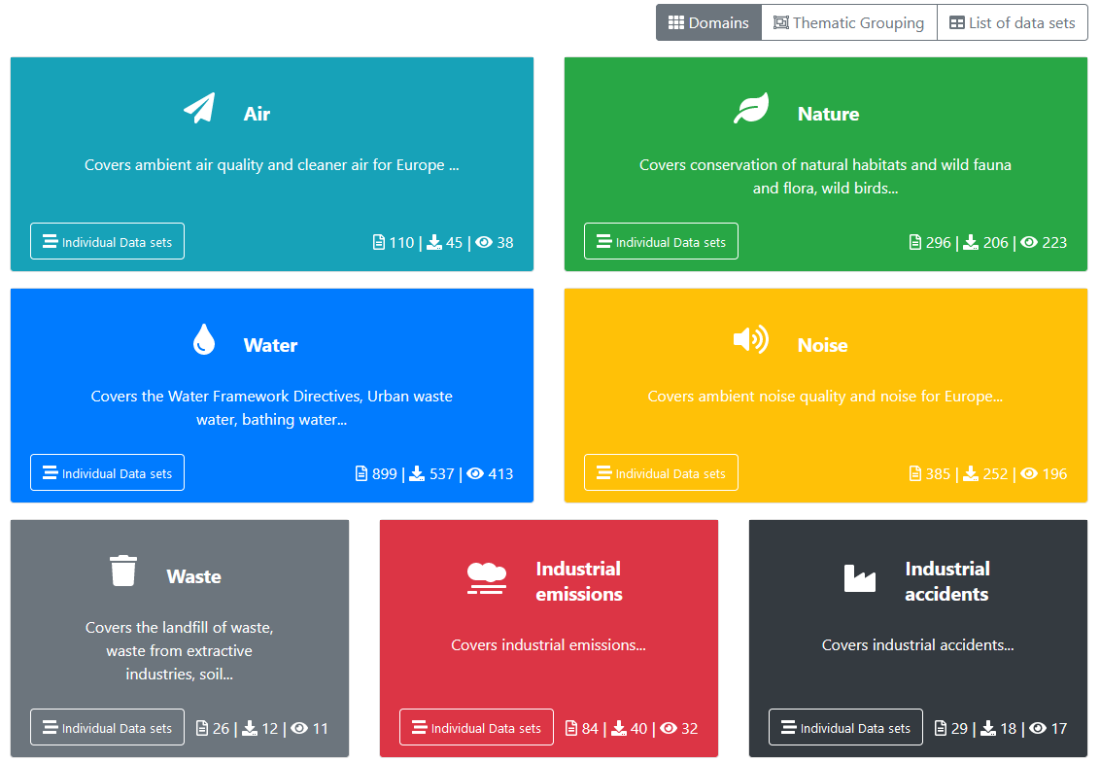
Task 2: Country overview of available datasets

Slide 3
WP 2020-2024 – Action 2.1 – working group composition
BACKGROUND
16. w2017 - 2018
Previous INSPIRE Working Group 2016.5 was asked to continue participation – all participating countries confirmed, minor change of experts
Extending action scope to other thematic domains
Nomination launch: invitation for nomination of new experts was launched in February 2021 (17.02.2021)
Nomination overview:
Number of experts: 46 (including alternative members)
Participating countries: 20 (AT, BE, CZ, DE, DK, ES, FI, FR, GR, HU, IE, IT, LU, MT, NL, NO, PT, SE, SI, SK)
Participation from EU level: EEA, DG ENV, JRC, ESTAT, DG CNECT

Slide 4
WP 2020-2024 – Action 2.1 – tasks
BACKGROUND
16. w2017 - 2018
Task | Links to related activities
1. Prioritisation methodology and processes | Follow up policy processes (EGD, 8th EAP)
2. Document the data priorities | EGD TF work, MS input
3. Manage the list(s) of priority datasets | MS to make data available (2016.5 task 2) Manage and update the list (2016.5 task 1) Under the umbrella of High Value Datasets (HVD) connect to core reference data and IACS Link EGD TF work on data inventories
4. Monitor implementation and address identified issues, including pilot projects | Monitor availability (2016.5 task 4) Work on selected blueprints (2016.5 task 3)
5. Process fast-track data requests (ad hoc) | DG ENV lead
6. Improve the INSPIRE Geoportal discoverability and visualisation | New INSPIRE action 2.4

Slide 5
Action 2.1 – Task 1
1. Prioritisation methodology and processes | Follow up policy processes (EGD, 8th EAP)
Drive further implementation of the Directive by real demand and tangible use cases.
Speed up the implementation by doing less but doing it quicker.
The data prioritisation methodology should consist of selecting those data sets that satisfy concrete needs of the stakeholders (local, regional, national and European administrations for implementation of Sustainable Development Goals, Community legislation, etc.) and for which interoperability should be pursued.
Beyond the scope of ongoing prioritisation initiatives (geospatial requirements paper, PDS …), data prioritisation should also consider the new political agenda and emerging legal frameworks
European Green Deal
8th Environmental Action Plan (2030 greenhouse gas emission reduction target, climate neutrality by 2050, strengthening resilience to climate change, a regenerative growth model in a green circular economy, zero-pollution ambition, biodiversity and enhancing natural capital, reducing environmental and climate pressures related to production and consumption)
High Value Data sets under the Open data directive
EU common data spaces under the data strategy
Draft action:
Develop methodology in detail

Slide 6

Action 2.1 – Task 2
2. Document the data priorities | EGD TF work, MS input
Document use cases for prioritised data by populating metadata/online form with
Specific data requirements
Linked business processes (Global, Europe, National, Regional, Local)
Reuse capacity (Global, Europe, National, Regional, Local)
Demonstrated (possible) data usage with real-life examples.
Draft action:
Develop and maintain list of use cases

Slide 7
Action 2.1 – Task 3
3. Manage the list(s) of priority datasets | MS to make data available (2016.5 task 2) Manage and update the list (2016.5 task 1) Under the umbrella of High Value Datasets (HVD) connect to core reference data and IACS Link EGD TF work on data inventories

Slide 8


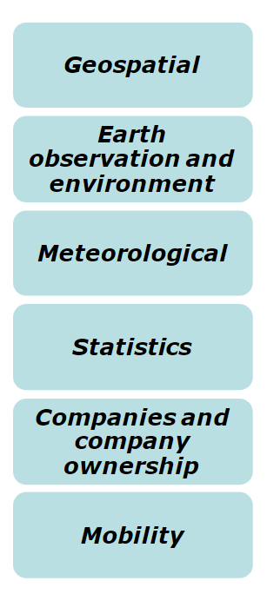
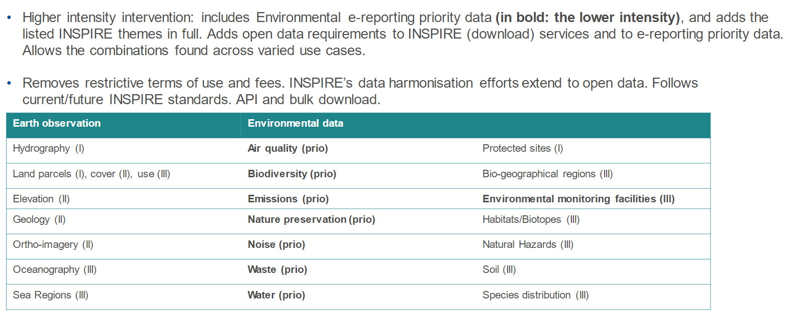
High Value Datasets: categories and key results
including
agricultural parcels and livestock - providing a link to IACS (DG AGRI)
Majority of core data sets (INSPIRE Annex I) - followed up by Eurostat
Background

Slide 9
Action 2.1 – Task 4
4. Monitor implementation and address identified issues, including pilot projects | Monitor availability (2016.5 task 4) Work on selected blueprints (2016.5 task 3)
Monitor availability
INSPIRE Geoportal – further development, e.g. visualisation
Information about other portals (e.g. Open Data Portal, environmental data portals and dashboards)
Harmonisation and interoperability – common pan-European data models – use case centric
Disseminate information on use cases
e-Reporting use case and INSPIRE priority list of datasets for e-Reporting (already well established)
Use cases supporting HVDS
Use cases supporting core reference data sets
Collect information provided by implementing communities (case by case) on INSPIRE streamlining, e.g. conceptual data modelling aligned with INSPIRE, data exchange formats, standards - for specific use cases
Discuss implementing issues
Support drafting INSPIRE Good Practice documents on use cases and implementation
Support implementation with specific guidelines

Slide 10
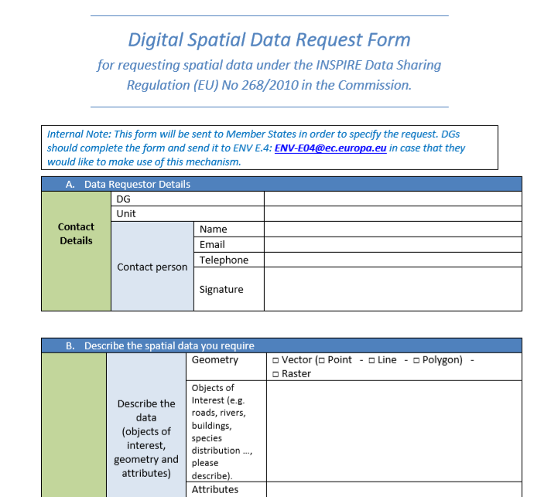
Action 2.1 – Task 5
5. Process fast-track data requests (ad hoc) | DG ENV lead
PROCEDURAL GUIDE ON THE APPLICATION OF THE INSPIRE DATA SHARING REGULATION (EU) NO 268/2010 IN THE COMMISSION
When a spatial data set is requested from a Member State, the Member State will be asked to provide the newly requested data set through the INSPIRE Geoportal and by implementing articles 5, 7 and 11 identical to the process of implementing the INSPIRE Directive for those datasets that they have identified themselves.
The procedural guide aims to ensure that Commission Regulation (EU) No 268/2010 is applied in such a way that:
requests to Member States are issued in a coherent, coordinated and formally correct way from all Commission services;
spatial data provided by Member States are made available to all Commission services in line with the “only once principle” and with minimal administrative burden;
Draft action:
Explore further the approach

